Slide 1
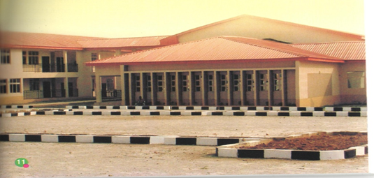
REVIEW OF EXISTING IGR DRIVES, THEIR IMPACT ON THE UNIVERSITY ANDPANS TO PROPEL EKSU IGR INITIATIVES:
POSITION OF THE COLLEGE OF MEDICINE
Prof Oluwadiya Kehinde
Provost, College of Medicine
Ekiti State University, Ado-Ekiti

Slide 2

Introduction
College of Medicine is expensive to setup and run
Colleges of medicine are usually funded directly by the government and transferred to the University
EKSU College of Medicine bucks this trend, as most of the buildings were built from the IGR of the University
This has put some undue strain on the University’s finances

Slide 3
College of Medicine: A Brief SWOT Analysis
Human Resources
The Teaching Hospital
Supportive University Management
Young and vibrant academic staff
STRENGTH

Slide 4
College of Medicine: A Brief SWOT Analysis
One Programme
Insufficient Infrastructure
Two more accreditations
WEAKNESS

Slide 5
College of Medicine: A Brief SWOT Analysis
Young academics
Attractive Course (s)
Large pool of potential clients
Only government Med School in the state
Virgin territory for medical researches
Institutes
OPPORTUNITY

Slide 6
College of Medicine: A Brief SWOT Analysis
The other medical school in Ado
Inability to attract professorial grade academics
MDCN Accreditation
Poor funding from owner state
THREATH

Slide 7

Improving the IGR Drive in the College
WHERE WE ARE
WHERE WE CAN BE…
TO
Hero
zero

Slide 8
Improving the IGR Drive in the College
WHERE WE ARE
WHERE WE CAN BE…
Animal House Generated about 120,000 naira
About 250 students
Medical Student Hostel (144 bed spaces)
UCH Model
Seven Undergraduate Courses
Vibrant PG Courses
More than one thousand students
Two Research Institutes
Medical Hostel (Close to 1000 bed spaces)

Slide 9

WHAT IS IMPORTANT…..
ATTITUDE
👍👍HALF FULL
👎👎NOT HALF EMPTY

Slide 10
OVERVIEW of College’s IGR Drive
What is Starting Soon…within weeks
What has been set in motion
Future Plans

Slide 11
Improving the College IGR: What is about to commence
At its August 2015 meeting, the College Academic Board raised a Committee to advise it on ways of improving the College IGR.
Their findings are as follows:
INTERNAL SOURCES
Department of Anatomy
A fully commercialized and self-sustaining ambulance and Embalming services. It is projected that if only 10 bodies are stored per month, N480,000 can generated. The plan is for this to start off by March this year.
Conduct corona case postmortem in conjunction with the Department of Anatomic Pathology

Slide 12
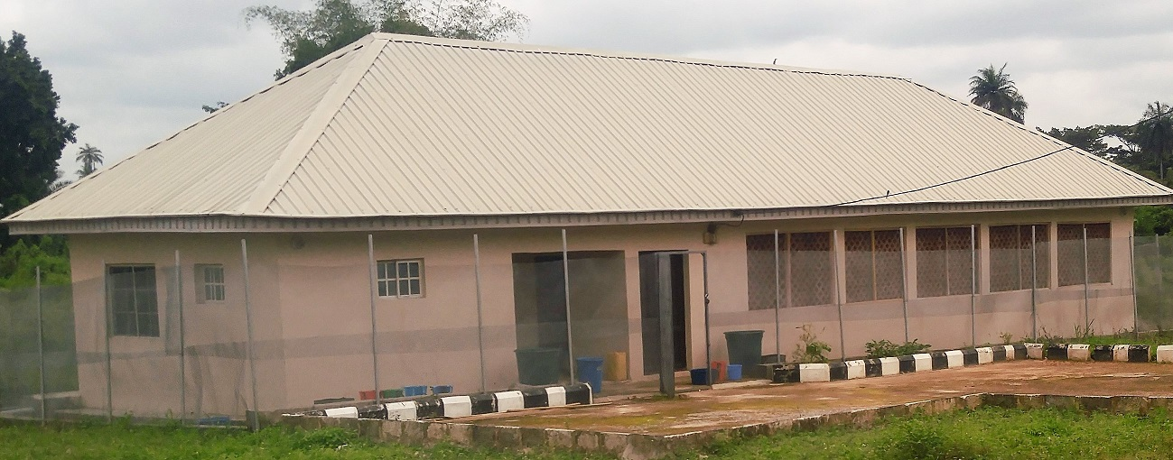
ANIMAL HOUSE
The Animal House has made about N120,000 since its inception.
Plans to broaden this include:
Advertising the animals available at the animal house on the University website and social medial platforms
Broaden the horizon of the animal house to include other animals
Our target is to start generating at least N30,000 per month by April this year.

Slide 13
CAFETERIA/BUTTERY
A cafeteria has been established in the College, and is being run on a PPP basis.
This will be expanded as the College population increases

Slide 14
Improving the College IGR: What has been set in motion
1. New Programs
UNDERGRADUATE
B.N. Sc. Nursing program
B. Sc. Anatomy
B. Sc. Physiology
Diploma in Mortuary Services
Diploma in Anatomical Services
POST GRADUATE
Master of Public Health (Regular)
Master of Public Health (Executive)

Slide 15
Improving the College IGR: What has been commenced
COLLEGE CONSULTANCY SERVICES
Aimed at harnessing the human & material resources of the College
A self-sustaining commercial venture
An advisory committee headed by Prof Oladele P. O , the Dean, Faculty of Management Sciences was setup to advise the College
Report has been submitted and presented at the College Academic Board meeting

Slide 16
Improving the College IGR: What has been set in motion
Committee’s Recommendations:
that the consultancy outfit should be registered with the Corporate Affairs Commission as a Limited Liability Company with the University as stakeholder.
that a Board and a Management Team should be constituted for the College Consultancy Services.
that the College should recruit a business driven person as the Project Manager. The Project Manager will be saddled with the responsibility of driving the business and marketing its services.
that the proposed Management Team suggested above should constitute the implementation Committee

Slide 17
Improving the College IGR: What has been set in motion
that provisions should be made for adequate funding for its take off
that members of the Implementation Committee should be encouraged to visit neighbouring institutions who are operating successful Consultancy services such as Obafemi Awolowo University, Ile – Ife, Lagos University Teaching Hospital, Idiaraba, Lagos, University Teaching Hospital, Ibadan and Ladoke Akintola University of Technology, Ogbomoso.

Slide 18
Improving the College IGR: What has been set in motion
SEMINARS AND WORKSHOPS for Corporate Entities
The Faculty could organize workshops/ seminars on preventive life style modifications involving all Departments, and that the seminar should be packaged in a way to attract the patronage of corporate bodies such as Banks, State and the National Assemblies etc. and also that the Faculty could originate proposals for sale to these corporate bodies.

Slide 19
Improving the College IGR: What has been set in motion
DIASPORA FUND RAISING
To raise funding through Ekiti indigene in diaspora
Has been set in motion with the active participation of the Chairman of the Council and some other Council members

Slide 20
Improving the College IGR: What has been set in motion
COLLABORATION BETWEEN COLLEGE OF MEDICINE AND FACULTY OF MANAGEMENT SCIENCES
This is to run a Postgraduate Diploma course in Hospital and Health Services Management
Master of Business Administration in the same field
Target clients include health workers e.g. Consultants, Medical Officers, Nurses, Community Health Officers and Health Information Managers etc.

Slide 21
Improving the College IGR: Future Plans
TELEMEDICINE
  Mobile telemedicine which includes teleconsultation, telediagnosis, teleeducation, telementoring and telemonitoring. This can be through sms and mms.
  Online telemedicine deployed through the internet on the University website and users can subscribe to it.
Notes:
Telemedicine has been broadly described as ‘the delivery of healthcare services, where distance is a critical factor, by all healthcare professionals using information and communication technologies for the exchange of valid information for diagnosis and prevention of diseases and injuries, research and evaluation, and for continuing education of healthcare providers, all in the interest of advancing the health of individuals and their communities’.

Slide 22
Improving the College IGR: Future Plans
COLLABORATION WITH THE TEACHING HOSPITAL.
The Teaching Hospital is the laboratory of the College. As such, both institutions need to explore areas where they can jointly deploy their joint expertise to improve their IGR. These areas include, but are not limited to:
    Telemedicine
    Public Health Monitoring
    Health Education

Slide 23
Improving the College IGR: Future Plans
FRIENDS OF THE COLLEGE:
Expansion of names of friends of the College to include non-partisan, reputable people from Ekiti State and beyond. E.g.
Chief Ade Ojo of Elizade group of Company
Chief Jimoh Ibrahim of Global Fleet Group of Companies
Sir (Engr) Oyedeji Olajubu, Managing Director Three Os Construction Company Nig. Ltd.

Slide 24
Improving the College IGR: Future Plans
COLLEGE FUND RAISING DINNER:
This has been discussed with the Chairman of the Council.
Participants will be eminent personalities from within and without Ekiti

Slide 25
THANK YOU

